Slide 1



UNIT 1
LESSON 2
MONEY MATTERS, PART 2

Slide 2
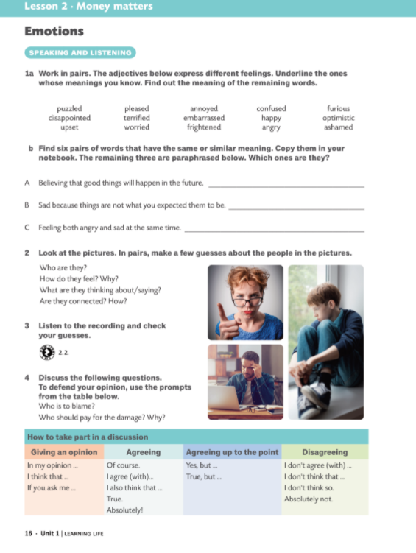



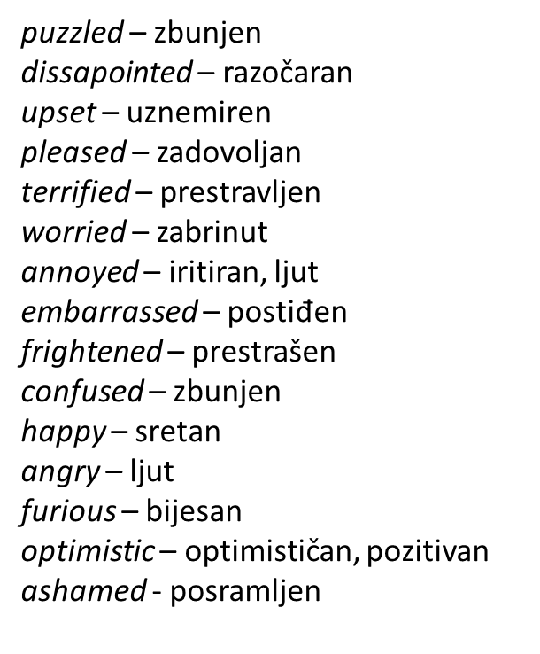

puzzled – confused
upset – worried
terrified – frightened
happy – pleased
furious – angry
ashamed - embarrassed
optimistic
disappointed
annoyed

Slide 3
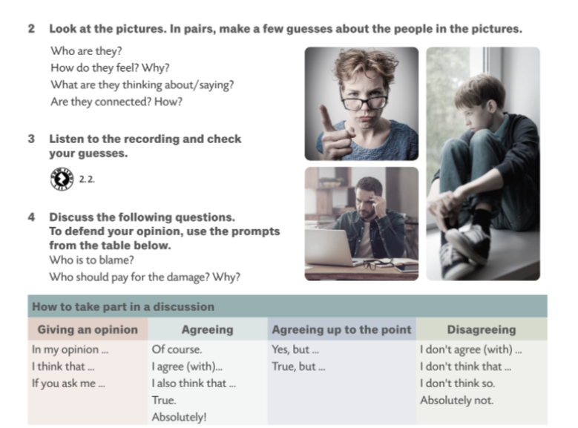
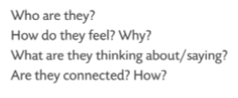






Slide 4
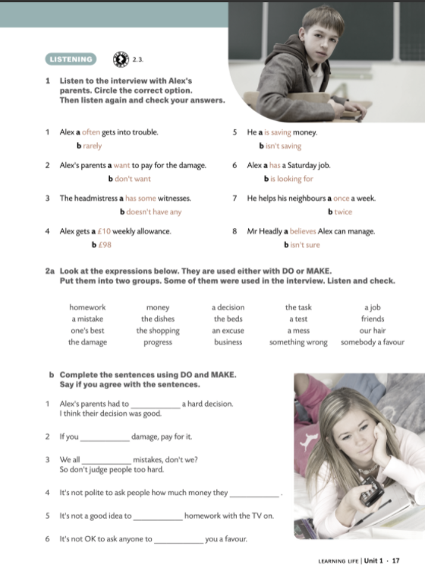



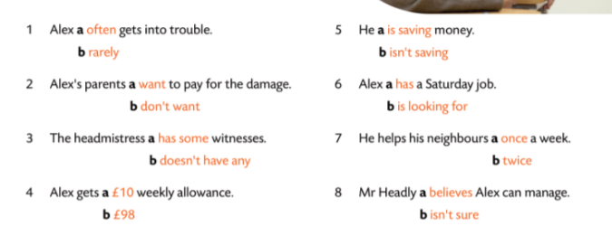
Money matters vocabulary

